Slide 1
Prenatal Exposure to Environmental Mixtures and Genomic Biomarkers of Disease
Anna R. Smith, MPH
UC Berkeley School of Public Health | Center for Computational Biology
Qualifying Examination
October 1, 2021

Slide 2


Background: DOHaD Hypothesis
Developmental Origins of Health and Disease (DOHaD) hypothesis
Exposures during critical periods of development impact long term health
Predictive adaptive responses
Functional changes foster short term resistance with lasting impacts
DOHaD evidence from nutrition and environmental health
Limited molecular markers to identify children at risk of postnatal disease from prenatal exposures
2
Notes:
-For example, developing fetus responds to the environment by predictive adaptive responses
-Foster short term resistance
-Subtle functional changes promote chronic disease later in life
Example. The link between early life environmental factors and later life disease was developed by David Barker, who in the mid-1980s showed that starvation of pregnant persons during the Dutch ‘hunger winter’ of the second world war was associated with increased risk of cardiovascular and metabolic diseases in their offspring at adulthood. The study underscored the significance of the timing of exposure. For instance, exposure to famine during early gestation resulted in babies who experienced elevated rates of obesity and cardiovascular disease in adulthood. In contrast, exposure during late gestation resulted in babies who were born small and continued to be small throughout their lives and had lower rates of obesity in adulthood. The concept that poor nutrition during organ development could lead to increased risk of disease later in life was originally called the Barker Hypothesis, then the Fetal Origin of Adult Disease, and now the Developmental Origins of Health and Disease (DOHaD). While the original focus was on how fetal malnutrition contributes to adult hypertension, obesity and insulin resistance, newer studies have identified other diseases that can result from fetal over- or under-nutrition including immunological, mental health, and reproductive diseases.
Work exploring the link between exposures to certain chemicals and drugs during early development and disease risk across the lifespan developed independently of the work on fetal malnutrition. The strongest data suggesting a link between developmental chemical exposures and later life disease include smoking, lead, methyl mercury, and diethylstilbestrol (DES), a pharmaceutical estrogen.

Slide 3




Background: Prenatal Metals
Maternal exposure to metals ubiquitous
Heavy metals generate reactive oxygen species (ROS) and deplete antioxidants
Essential metals act as antioxidants
During pregnancy, physiological changes increase partitioning of metals
3
Notes:
-Ambient and indoor air pollution, soil contact, drinking water, diet
-Influence maternal and child health
-Both nonessential and essential metal exposure during pregnancy may have implications for the developing fetus.
-Heavy metals generate reactive oxygen species (ROS), deplete antioxidants, and bond to sulfhydryl groups
-Leads to inflammation, oxidative stress, and genotoxicity
-During pregnancy, physiological changes increase partitioning of metals and affect maternal and child health
-Lead mobilized from bone during pregnancy
-Some metals cross placental barrier
-Other metals accumulate in placenta

Slide 4
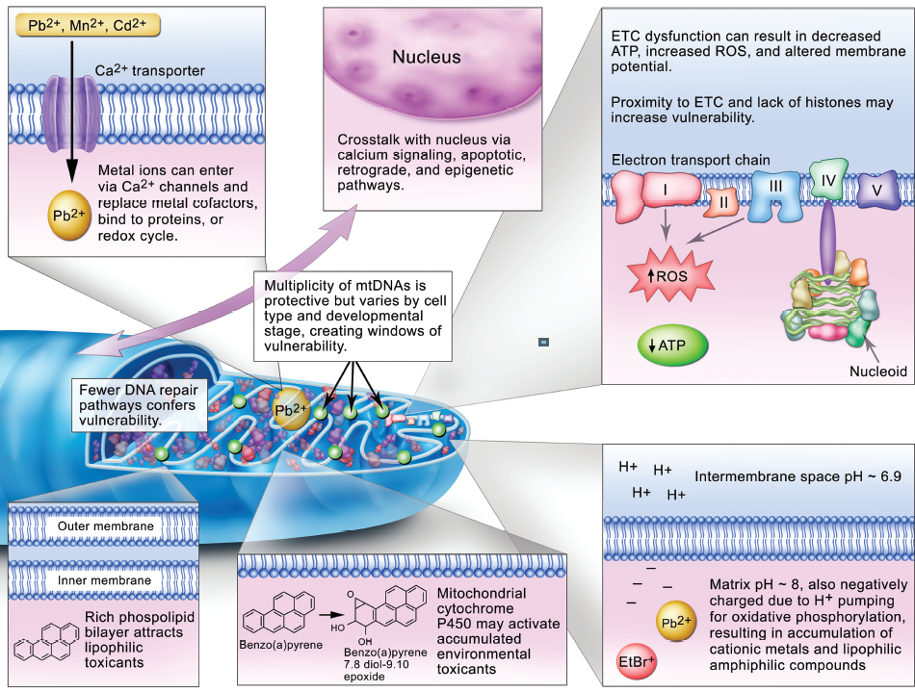
Background: Disease Pathway Biomarkers
Mitochondrial DNA copy number = measure of mitochondrial genome abundance
Reflect mitochondrial dysfunction & oxidative stress response
Telomeres = DNA-protein structures at end of chromosomes
Preserve chromosome integrity;
aging marker
Both associated with aging, psychiatric, cardiovascular, metabolic, autoimmune, and severe COVID-19 disease
Image: Meyer et al. 2013, Journal of Tox Sciences
4
Notes:
-Mitochondria = main cellular site for oxidative phosphorylation and reactive oxidant species generation
-Metals preferentially accumulate inside mitochondria via calcium transporters
-mtDNA = prime target for metal induced oxidative damage; lack histones and repair capabilities
Cells generally contain 10²-10⁴ copies of mtDNA
Under high oxidative stress conditions (i.e., acute exposure) mtDNA copy number (mtDNAcn) increases to compensate for decreased energy production
Under reduced antioxidant capacity (i.e., chronic exposure), oxidative stress can overwhelm the mitochondria resulting reduced mtDNAcn
-Telomeres = DNA-protein structures at end of chromosomes that preserve chromosome integrity & are human aging marker
Telomere attrition mediated by mitochondrial dysfunction and generates further oxidative stress and inflammation
Oxidative stress and inflammation accelerates telomere attrition
Telomere dysfunction induced by chronic inflammation and oxidative stress attributed to imbalance between production of ROS and cellular antioxidant defenses
-Image: The ends of chromosomes are protected by specific DNA sequences called telomeres, visualized here in red.

Slide 5
Background: Childhood Adiposity
1/5 children overweight or obese worldwide
Obesity epidemic parallel to increase in use and exposure to chemicals
Chemical “obesogens” disrupt metabolic processes at various developmental stages
Prior evidence
Single prenatal heavy metals postnatal obesity
Metal mixtures in adulthood adult body mass index
Research Gaps:
Prenatal metal mixtures childhood adiposity
5
Notes:
-Often stay obese in adulthood; develop comorbidities
-Metabolic diseases costly, debilitating, public health threat
-Endocrine disrupting chemicals = obesogens
-Disrupt metabolic processes at various developmental stages
-Recently, postnatal metal mixtures and adult adiposity

Slide 6
Specific Aims
Aim 1: Evaluate associations between prenatal exposure to metal mixtures during the first trimester and mitochondrial DNA copy number (mtDNAcn) and telomere length (TL) in maternal second trimester and cord blood.
Aim 2: To determine whether prenatal exposure to metal mixtures during the first trimester is associated with adipocyte-secreted hormones at birth (adiponectin and leptin) and adiposity and body size measurements during early- and mid-childhood and early teen.
Aim 3: Determine if any association between prenatal metals and childhood adiposity is mediated by cord blood mtDNAcn, TL, or adipocyte-secreted hormones.
6

Slide 7
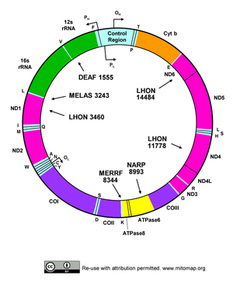
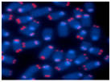
Study Objectives
Aim 1: Evaluate associations between prenatal first trimester metal mixtures and mitochondrial DNA copy number (mtDNAcn) and telomere length (TL) in maternal second trimester and cord blood.
Prenatal metal mixture
As, Ba, Cd, Cs, Hg, Mg, Mn, Pb, Se, Zn
Maternal blood
Cord blood
7

Slide 8
Study Methods: Study Population and Design (Aim 1)
Study Population and Design (Project Viva)
Prospective pre-birth cohort study
2,128 mother-infant pairs recruited between 1999-2002, during 1st prenatal visit at multispecialty group practice in eastern Massachusetts
Eligibility criteria: fluency in English, gestational age <22 weeks, singleton pregnancy
Exposure Assessment
Metal concentrations measured in 1st trimester red blood cells (N=1390) with Inductively Coupled Plasma Mass Spectrometry; Direct Mercury Analyzer 80 for mercury
Six nonessential metals (arsenic, barium, cadmium, cesium, lead, mercury)
Four essential metals (magnesium, manganese, selenium, zinc)
Outcome Assessment
TL in 2nd trimester maternal (N=893) and cord (N=408) blood using quantitative polymerase chain reaction (qPCR); compares relative amplification of TL repeat copy # to single gene (albumin) copy #
mtDNAcn in 2nd trimester maternal (N=898) and cord (N=419) blood using qPCR; compares relative amplification of nuclear and mitochondrial segments of DNA
8
Notes:
Eligibility criteria: fluency in English, gestational age <22 weeks, singleton pregnancy

Slide 9
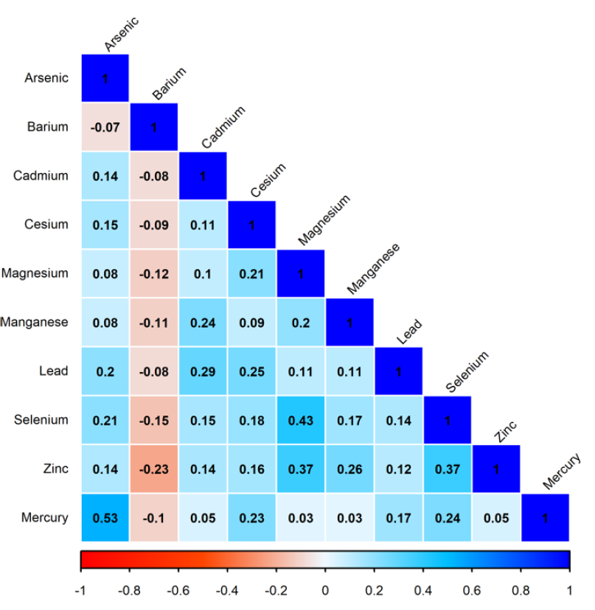
Study Methods:
Exposure Characterization
Table 1. Geometric mean (GM) and standard deviation (SD) of metals in maternal first trimester blood samples (N = 1390).
Metal | GM ± SD (ng/g) | Intra-class correlation | % above limit of detection (LOD)
Arsenic | 0.8 ± 2.8 | 0.89 | 90%
Barium | 3.6 ± 2.3 | 0.82 | 99%
Cadmium | 0.4 ± 2.1 | 0.93 | 95%
Cesium | 2.5 ± 1.4 | 0.90 | 100%
Lead | 18.0 ± 1.5 | 0.96 | 100%
Magnesium | 41095.1 ± 1.2 | 0.73 | 100%
Manganese | 16.0 ± 1.5 | 0.83 | 100%
Mercury | 2.9 ± 3.5 | 0.92 | 97%
Selenium | 250.1 ± 1.2 | 0.77 | 100%
Zinc | 10299.3 ± 1.2 | 0.75 | 100%
Figure 1. Spearman correlation coefficients for prenatal metal concentrations (N=1390).
9
Notes:
-Note that this population is an urban, middle class, mostly white population, and we still have relatively high detection of these metals in blood.
Reflects general population-level exposures (no known high exposure sources)
-All metals selected in this study at an intra-class correlation above 0.70 for duplicates and a percent detection of 90% or above.
-Mg and Se levels high, since they are driven by dietary sources
-Metals showed low to moderate correlation. Arsenic and mercury had the highest correlation (0.53) (likely due to fish consumption), followed by magnesium and selenium (0.43), magnesium and zinc (0.37), selenium and zinc (0.37). Barium and zinc had the highest negative correlation (-0.23).
Note: Measured total arsenic (organic and inorganic detected) (limitation) inorganic arsenic = toxic

Slide 10
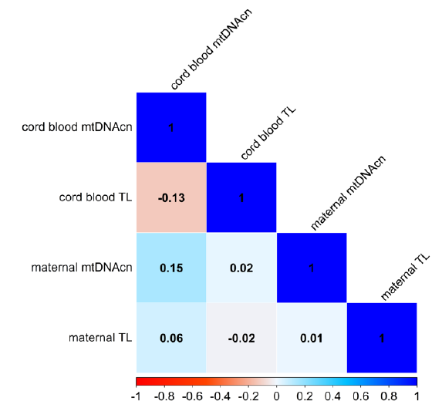
Study Methods:
Outcome Characterization
Maternal second trimester and umbilical cord blood mtDNAcn and TL
TL = sample’s TL relative to population average for study
mtDNAcn = sample’s mtDNAcn relative to population average for study
Table 2. Median (interquartile range) of outcome variables.
Relative mtDNAcn |  | Relative TL | Relative TL
Maternal (N=898) | Cord blood (N=419) | Maternal (N=893) | Cord blood (N=408)
0.99 (0.32) | 0.97 (0.29) | 0.64 (0.18) | 1.06 (0.48)
Figure 2. Spearman correlation coefficients among biomarker residuals after regressing plate effects.
10
Notes:
Population average includes maternal and cord blood samples

Slide 11
Study Methods: Statistical Analysis (Aim 1)
Individual metal analysis: Adjusted linear regression models
Metal mixture analysis:
Quantile g-computation (overall mixture effect and toxic metal ID)
Estimate change in outcome for one quantile, simultaneous increase in all exposures in a specified mixture (mixture exposure-response)
Bayesian Kernel Machine Regression (BKMR) with component-wise variable selection (overall mixture effect, toxic metal ID, check for non-linearity and interactions)
Combines nonparametric Gaussian process regression (allows flexible exposure-response functions) with Bayesian variable selection (improves inference with highly correlated variables)
Covariates: sample plate, maternal age, pre-pregnancy BMI, race, education, income, smoking during pregnancy, parity, child sex
11
Notes:
Highlight that in general, people have been modeling a single exposure at a time. Not realistic for epidemiological studies (more realistic in experimental setting). Paints bigger picture of metal exposure.
Quantile g-computation model, parametric, generalized-linear-model based implementation of g-computation, implemented by categorizing all metals in quartiles and fitting linear model. Quartile values treated as continuous. Exposure-response estimator = sum of regression coefficients across included exposures. If metals have different directions of effect, weights interpreted as proportion of positive (or negative) partial effect and together sum to 2.0.
BKMR allows for the flexible modeling of individual exposures, as well as the mixture. The flexibility of BKMR for fitting complex exposure-response curves is based on combining nonparametric Gaussian process regression, which allows flexible exposure-response functions, with Bayesian variable selection, which improves inference with highly correlated variables. The kernel does not impose a functional form on the exposure response relationship, thus capturing a wide range of relationships, including nonlinear exposure-response functions and nonlinear and non-additive interactions among all mixture members.
Since the metals were mildly to moderately correlated, we chose component-wise variable selection, which treats each metal as exchangeable when entering the model, instead of hierarchical variable selection, which would have accounted for high correlation patterns or shared sources of exposure.

Slide 12
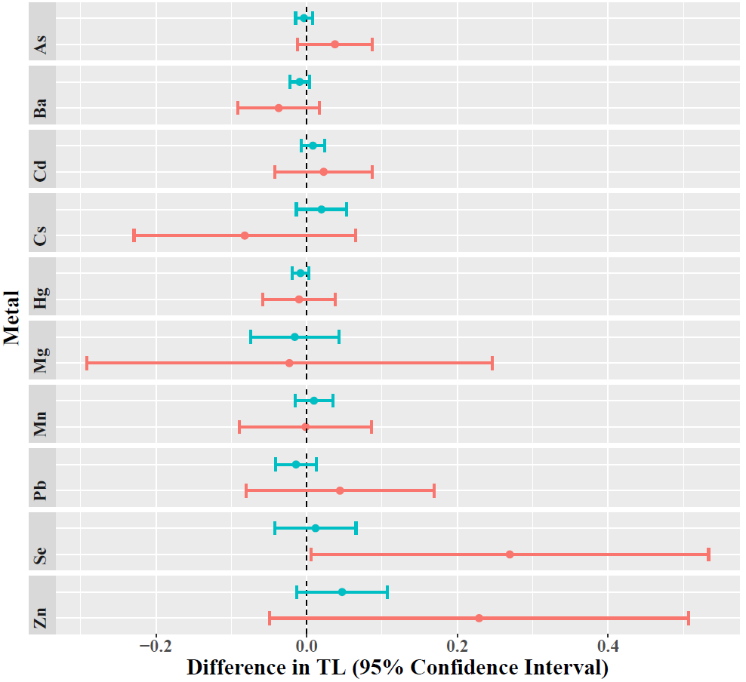
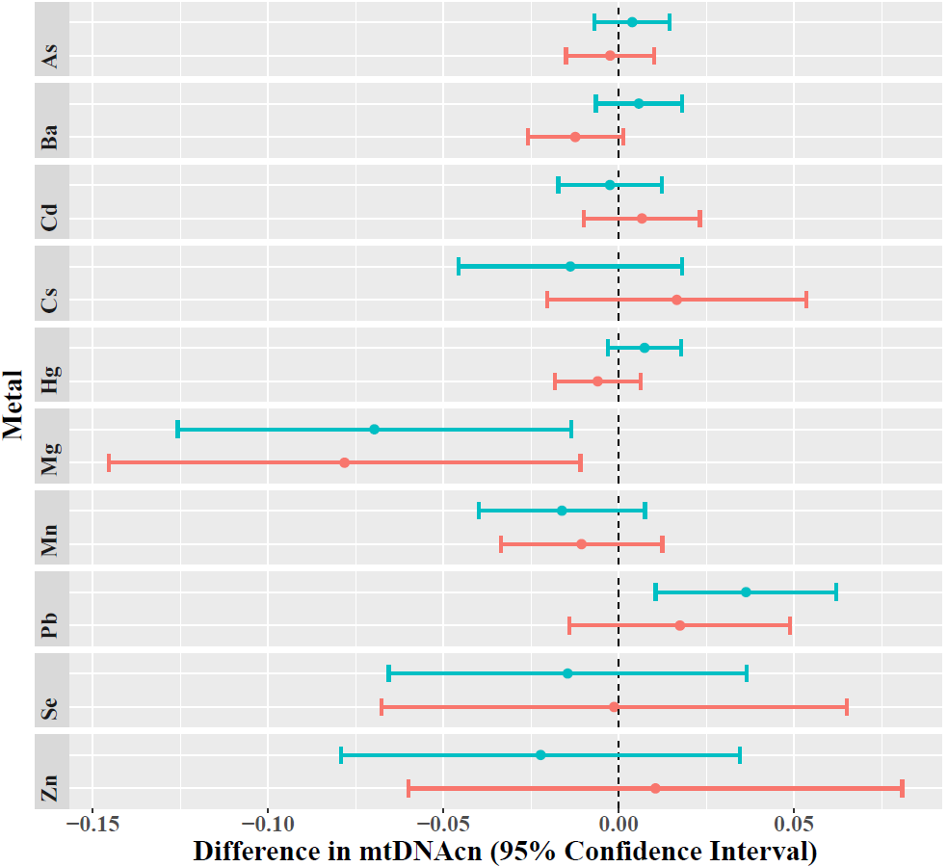
Preliminary Results (Aim 1)
Linear Regression
Two-fold increase in maternal selenium associated with longer cord blood TL
Two-fold increase in maternal magnesium associated with decreased maternal and cord blood mtDNAcn
Two-fold increase in maternal lead associated with increased maternal mtDNAcn
Figure 3. Associations between concentrations of individual metals and maternal (green/top) and cord blood (red/bottom) telomere length (TL) and mitochondrial DNA copy number (mtDNAcn).
12
Notes:
Effect estimates are change in TL or mtDNAcn associated with a two-fold increase in metal concentration, adjusted for covariates.

Slide 13
Preliminary Results (Aim 1)
Quantile g-computation
Nonessential metal mixture (arsenic, barium, cadmium, cesium, lead, mercury) associated with higher maternal mtDNAcn (β=0.04, 95% CI: 0.01, 0.07)
13
Notes:
Association between essential metal mixture (magnesium, manganese, selenium, zinc) and lower maternal mtDNAcn (β=-0.02, 95% CI: -0.04, 0.003)
Association between nonessential metal mixture and shorter maternal TL (β=-0.03, 95% CI: -0.06, 0.005)

Slide 14
Study Objectives
Aim 2: To determine whether prenatal exposure to first trimester metal mixtures is associated with adipocyte-secreted hormones at birth (adiponectin and leptin) and adiposity and body size measurements during early- and mid-childhood and early teen.
Prenatal metal mixture
As, Ba, Cd, Cs, Hg, Mg, Mn, Pb, Se, Zn
Cord blood leptin and adiponectin
Adiposity and body size at early- and mid-childhood and early teen
14

Slide 15
Study Methods: Study Population and Design (Aim 2)
Study Population and Design (Project Viva)
Prospective pre-birth cohort study of prenatal exposures and child health
2,128 mother-infant pairs recruited between 1999-2002, during 1st prenatal visit at multispecialty group practice in eastern Massachusetts
Eligibility criteria: fluency in English, gestational age <22 weeks, singleton pregnancy
Exposure Assessment
Metal concentrations measured in 1st trimester red blood cells (N=1390) with Inductively Coupled Plasma Mass Spectrometry; Direct Mercury Analyzer 80 for mercury
Six nonessential metals (arsenic, barium, cadmium, cesium, lead, mercury)
Four essential metals (magnesium, manganese, selenium, zinc)
Outcome Assessment
Adiponectin (N=613) and leptin (N=590) in cord blood
Body size at early- and mid-childhood and early teen: sum of skinfold thicknesses, waist circumference, body mass index z-score (N=700-800)
Adiposity at mid-childhood and early teen: total dual-energy x-ray absorptiometry (DXA) fat-mass-index and DXA trunk-fat-mass-index (N=500-600)
15

Slide 16
Study Methods: Statistical Analysis (Aim 2)
Individual metal analysis: Adjusted linear regression models and generalized estimating equations
Metal mixture analysis:
Quantile g-computation (overall mixture effect and toxic metal ID)
Estimate change in outcome for one quantile, simultaneous increase in all exposures in a specified mixture (mixture exposure-response)
Bayesian Kernel Machine Regression (BKMR) with component-wise variable selection (overall mixture effect, toxic metal ID, check for non-linearity and interactions)
Combines nonparametric Gaussian process regression (allows flexible exposure-response functions) with Bayesian variable selection (improves inference with highly correlated variables)
Covariates: maternal age at pregnancy, pre-pregnancy BMI, education, household income, race, smoking status, parity, child sex at birth, and child age (GEE only)
16

Slide 17
Preliminary Results (Aim 2)
Adjusted linear regression models
Two-fold increase in prenatal magnesium associated with higher cord blood leptin (β=2.9, 95% CI: 0.9, 4.9).
Two-fold increase in cadmium associated with increased SST at early childhood (β=0.3, 95% CI: 0.02, 0.6), and higher DXA total (β=0.3, 95% CI: 0.02, 0.5) and trunk fat (β=0.1, 95% CI: 0.01, 0.2) at early teen.
Two-fold increase in cesium associated with higher BMI z-score at mid-childhood (β=0.2, CI: 0.02, 0.4) and DXA trunk fat (β=0.2, 95% CI: 0.003, 0.5) at early teen
Adjusted generalized estimating equations
Higher levels of prenatal cesium associated with higher DXA total fat (β=0.4, 95% CI: 0.1, 0.7), trunk fat (β=0.2, 95% CI: 0.03, 0.3), and body mass index z-score (β=0.1, 95% CI: 0.02, 0.2).
Higher manganese associated with lower sum of skinfold thicknesses (β=-0.7, 95% CI: -1.2, -0.2).
17

Slide 18
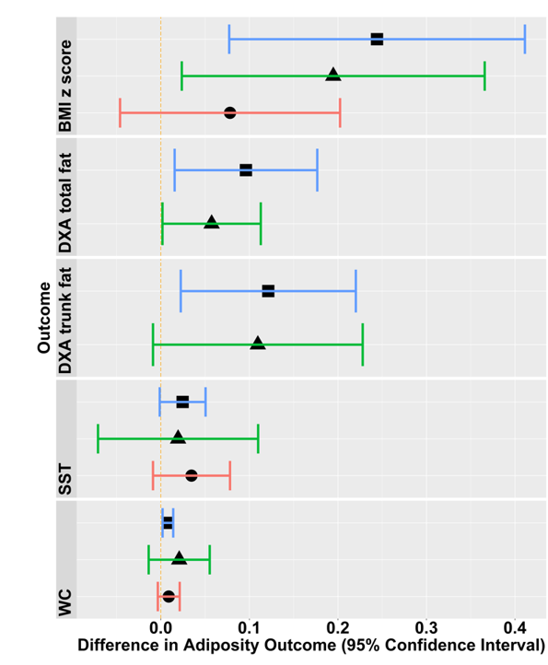
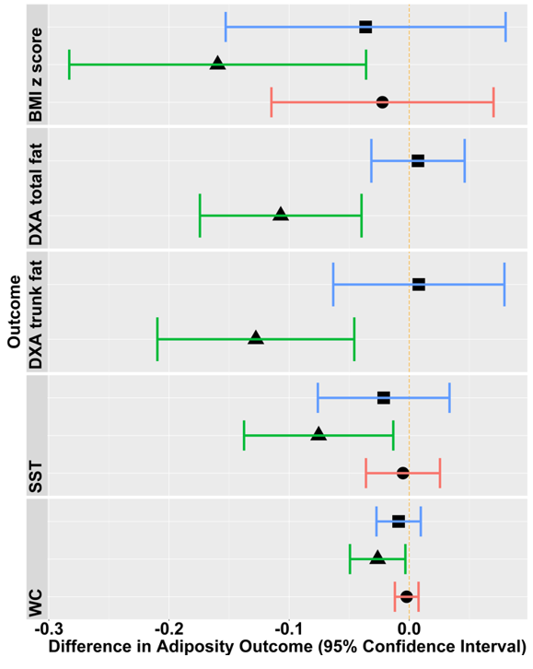
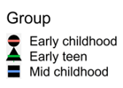
Preliminary Results (Aim 2)
Nonessential metal mixture
arsenic, barium, cadmium, cesium lead, mercury
Essential metal mixture
magnesium, manganese, selenium, zinc
Quantile g-computation
Nonessential metal mixture associated with higher body mass index z-score, waist circumference, and DXA total- and trunk fat at mid-childhood
Nonessential metal mixture associated with higher body mass index z-score and DXA total fat at early teen
Essential metal mixture associated with lower body mass index z-score, waist circumference, sum of skinfold thicknesses, and DXA total- & trunk fat at early teen & higher cord blood leptin
Figure 4. Associations between each outcome and a one quartile increase in mixture, conditional on covariates & metals not included in the mixture, and 95% bootstrap CIs
18

Slide 19
Study Objectives
Aim 3: Determine if any association between prenatal metals and childhood adiposity is mediated by cord blood mtDNAcn, TL, or adipocyte-secreted hormones.
Prenatal metal mixture
As, Ba, Cd, Cs, Hg, Mg, Mn, Pb, Se, Zn
Cord blood
Adiposity and body size at early- and mid-childhood and early teen
OR
Cord blood leptin and adiponectin
19

Slide 20
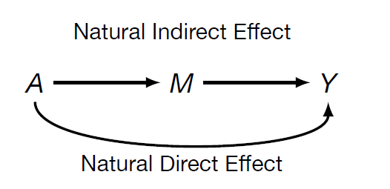
Study Methods: Statistical Analysis (Aim 3)
Identify individual metals and metal mixtures associated with both markers of adiposity and body size, as well as the candidate mediators (mtDNAcn, TL, adiponectin, and/or leptin in cord blood)
Utilize causal inference framework to estimate natural direct and indirect effects
Decompose effect of A (metals) into its indirect effect (through a biomarker) and its direct effect (everything else); allows for exposure-mediator interactions (pure vs. total natural direct and indirect effects)
Bootstrap standard errors to compute 95% confidence intervals and perform inference tests
Use quantile g-computation estimator to summarize the mixture (A)
20

Slide 21
Study Methods: Potential Mediator Candidates (Aim 3)
Prenatal magnesium → cord blood leptin (hormone mediator) → early teen WC
Prenatal magnesium → cord blood mtDNAcn (oxidative stress mediator) → early teen WC
Prenatal essential metals → cord blood leptin (hormone mediator) → each early teen adiposity measure
21
Notes:
Mediation analysis must satisfy the following criteria: (1) changes in the exposure level cause a significant change in the outcome, (2) the changes in the mediator can be greatly affected by the change in levels of the exposure, (3) the mediator is significantly related to the outcome.
Prior Project Viva study
Higher cord blood leptin associated with lower BMI z-score, waist circumference, sum of skinfold thicknesses during childhood
Each 10 ng/mL increment of cord blood leptin associated with a reduction in BMI z score and higher leptin levels at 3 years but not with skinfold thicknesses.
Each 10 microg/mL increment of cord blood adiponectin was positively associated with a higher subscapular skinfold thickness/triceps skinfold thickness ratio at 3 years.
High leptin levels in cord blood correlated with fetal adiposity at birth. Adiponectin inversely related to leptin.
Hypothesis: lower leptin levels at birth would activate hypothalamic appetite centers and neuroendocrine mechanisms that would result in increased weight at 6 months and 3 years of age (leptin resistance).
Cord blood adipocyte-hormone mechanisms not fully elucidated.
Two-fold increase in prenatal magnesium marginally associated with lower early teen waist circumference (main effect)
Two-fold increase in prenatal magnesium associated with higher cord blood leptin and lower cord blood mtDNAcn (candidate mediators)
Essential metal mixture associated with lower body mass index z-score, waist circumference, sum of skinfold thicknesses, and DXA total- & trunk fat at early teen
Essential metal mixture associated with higher cord blood leptin (candidate mediator).

Slide 22
Summary
Aim 1:
Exposure: Prenatal nonessential and essential metals
Outcome: Maternal and cord blood mtDNAcn and TL
Aim 2:
Exposure: Prenatal nonessential and essential metals
Outcome: Cord blood adipocyte-secreted hormones and childhood adiposity
Aim 3:
Mediation
22

Slide 23
Future Directions (Long-Term)
Validate findings in other cohorts with different metal exposure profiles
Explore adding additional mixture components, such as dietary or social exposures
Examine effect of metal mixtures on cord blood epigenetic marks, including epigenetic age acceleration
Explore nonparametric approaches for mixture analyses for aims 1 and 2, as well novel mixture mediation approaches for aim 3
23

Slide 24
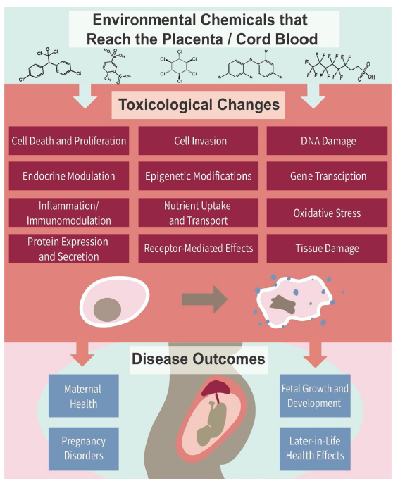
Public Health Significance
Biomarkers elucidate molecular mechanisms linking prenatal exposures to postnatal disease
Effect of mixtures of prenatal exposures
Combinations of exposures that influence health outcomes
Protective exposures
Relevant for risk assessment, clinical, and policy recommendations
24

Slide 25
Acknowledgements
UC Berkeley School of Public Health
Andres Cardenas, PhD, MPH (program adviser)
Nina Holland, PhD (program adviser)
Ellen Eisen, ScD (committee member)
Jay Graham, PhD, MBA, MPH (committee member)
Rosemarie de la Rosa, PhD, MPH (committee member)
Alan Hubbard, PhD (committee member)
Columbia University, Mailman School of Public Health
Andrea A. Baccarelli, MD, PhD, MPH
Harvard T.H. Chan School of Public Health
Diane R. Gold, MD, MPH
Brent Coull, PhD
Icahn School of Medicine at Mount Sinai
Chitra Amarasiriwardena, PhD
Robert O. Wright, MD, MPH
Boston University School of Public Health
Birgit G. Claus Henn, ScD, MPH
Harvard Medical School &
Harvard Pilgrim Health Care Institute
Pi-I Debby Lin, ScD, MS
Sheryl L. Rifas-Shiman, MPH
Mohammad L. Rahman, MD, ScD, MPH
Marie-France Hivert, MD, MMSc
Emily Oken, MD, MPH
Funding
United States National Institutes of Health
The Children’s Health Exposure Analysis Resource (CHEAR)
We thank the participants and staff of the Project Viva study.
25

Slide 26
Supplemental Slides

Slide 27
Exposure Profile Comparisons

Slide 28
Study Methods: Study Sample Characteristics
Supplemental Table 1. Sample characteristics of mother-child pairs from the Project Viva cohort with complete measurements for all metals.
Characteristic | N (%)
Overall | 1390 (100)
Maternal Age (years)
Quartile 1 (16.9-29.9) | 352 (25.38)
Quartile 2 [29.9-32.6) | 339 (24.44)
Quartile 3 [32.6-35.9) | 360 (25.96)
Quartile 4 [35.9-45.0) | 336 (24.22)
Maternal Body Mass Index
Underweight (<18.5) | 44 (3.17)
Normal [18.5-25.0) | 815 (58.63)
Overweight [25.0-30.0) | 308 (22.16)
Obese [≥30.0] | 223 (16.04)
Maternal Race/ethnicity
Asian | 62 (4.46)
Black | 179 (12.88)
Hispanic | 95 (6.83)
Mixed race | 47 (3.38)
White | 1007 (72.45)
Maternal Education
Less than college | 432 (31.08)
College graduate | 958 (68.92)
Household Income
<$70,000 per year | 551 (39.64)
≥$70,000 per year | 839 (60.36)
Smoking
Never | 953 (68.56)
Prior to pregnancy | 266 (19.14)
During pregnancy | 171 (12.30)
Parity
Nulliparous | 674 (48.49)
One or more | 716 (51.51)
Infant Sex
Male | 718 (51.65)
Female | 672 (48.35)
Infant Race/ethnicity
Asian | 48 (3.45)
Black | 181 (13.02)
Hispanic | 75 (5.40)
Mixed race | 120 (8.63)
White | 966 (69.50)
Notes:
As shown in the table, most mothers were white, had at last a college education, never smoked, had normal pre-pregnancy BMI, lived in a household with an income greater than $70,000, and were between 30-35 years at the time of pregnancy.

Slide 29
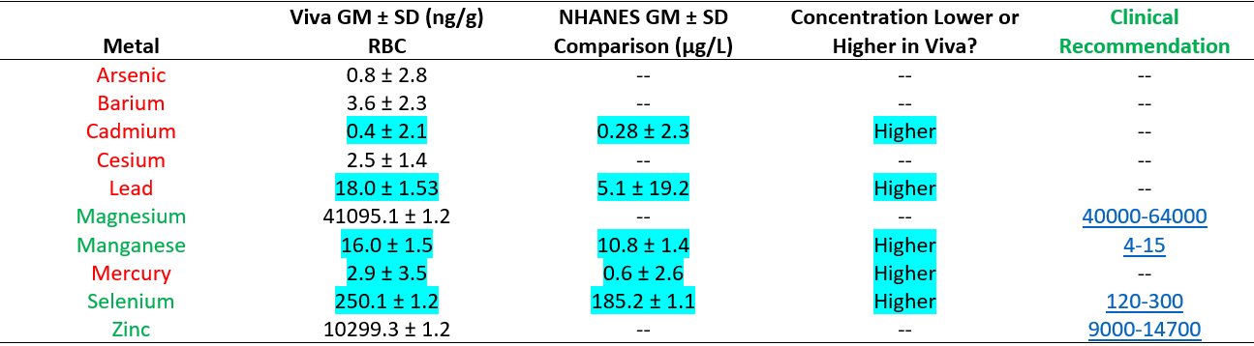
Project Viva [Metal] Compared with NHANES
Supplemental Table 2. Geometric mean (GM) and standard deviation (SD) of metals in maternal first trimester blood samples (N=1390), compared to 2017-2018 subset of female National Health and Nutrition Examination Survey (NHANES) participants ages 16-45 years (N=1308).
Notes:
Metal concentrations are in ppb for both cohorts
Regulatory levels
Lead 5 µg/dL was adopted by CDC in 2012 as the upper reference range value for BLLs in children as an advisory level for environmental and educational intervention (NHANES: 0.51 µg/dL)
Arsenic in drinking water 10 ppb limit

Slide 30
Mechanisms

Slide 31
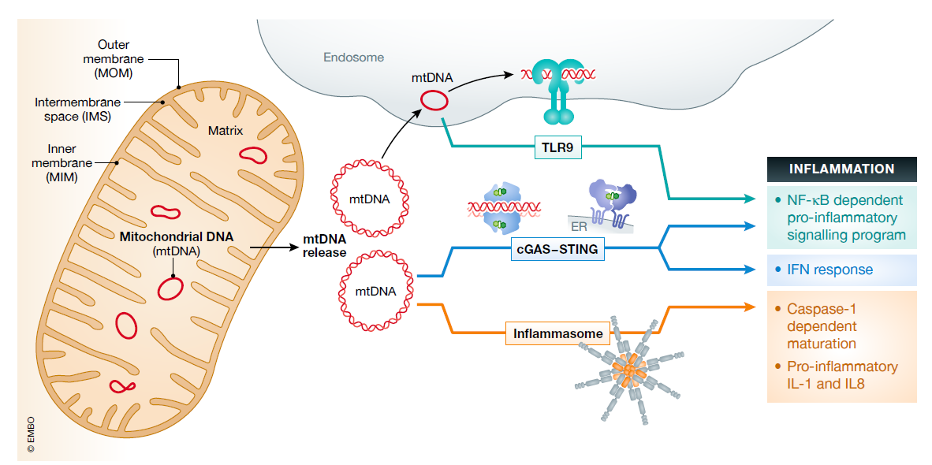
Image: Riley and Tait 2020
Notes:
Recent evidence showed that decreased expression of TFAM, mitochondrial transcription factor A, resulted in mtDNA stress signaling. In primary TFAM heterozygous cells, the decreased TFAM protein levels caused an alteration mtDNA packaging, as evidenced by large mtDNA structures observed in primary TFAM heterozygous cells, allowing fragmented mtDNA to be released in the cytosol to activate the cyclic GMP-AMP synthase (cGAS). Thus, any process that reduces TFAM function may activate mtDNA stress signaling, contributing to a proinflammatory environment that could alter disease trajectory and tissue function.
Mitochondrial dysfunction, in conjunction with altered mitochondrial dynamics, is a major factor observed in neurodegenerative diseases. In this review, we compiled the literature indicating that changes in mtDNA and TFAM protein levels occur in multiple neurodegenerative diseases, and the impact of gain-of-function and loss-of-function manipulations of TFAM in aging and neurodegenerative models.

Slide 32
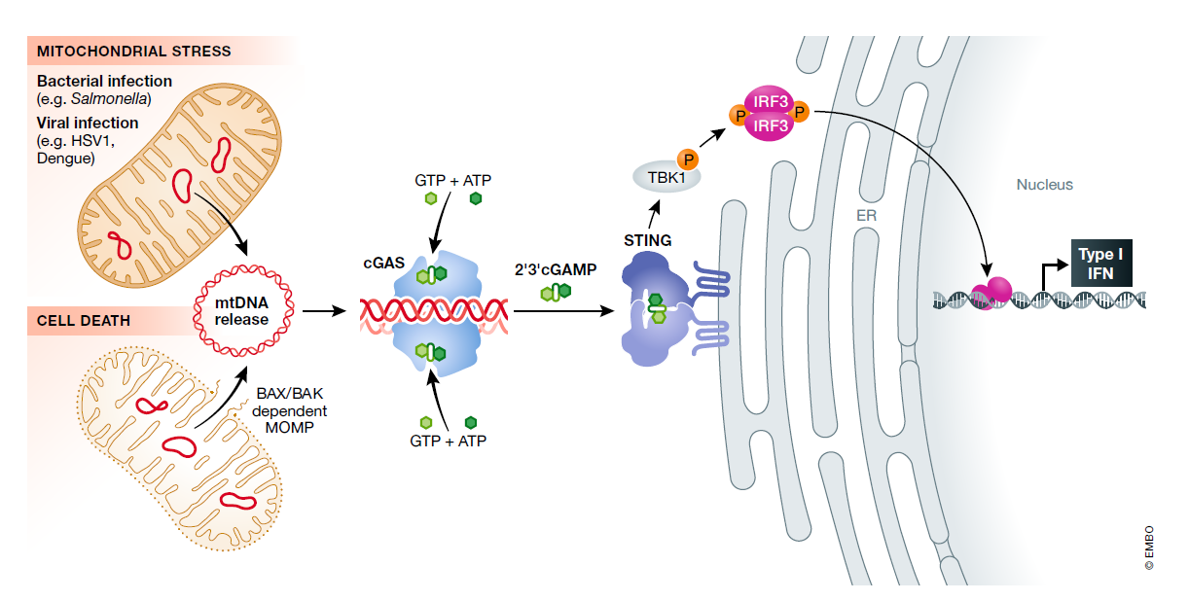
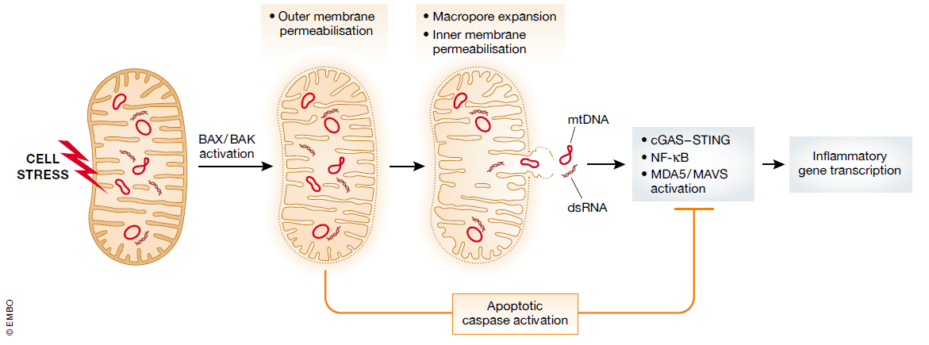
Image: Riley and Tait 2020
Notes:
During programmed cell death, the pro-apoptotic proteins BAX and BAK permeabilise the mitochondrial outer membrane to allow the passage of pro-apoptotic molecules to move from the inner membrane space into the cytosol, where they can initiate a caspase cascade, resulting in a rapid cell death

Slide 33
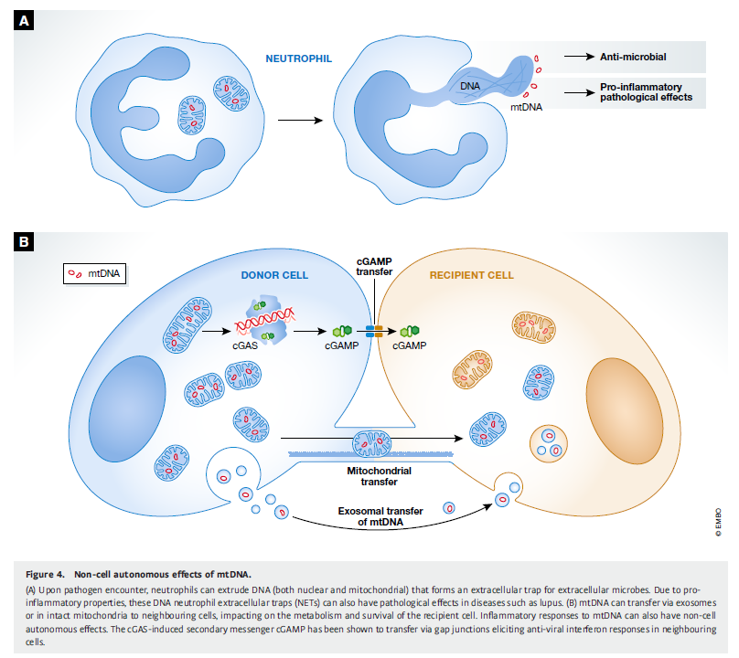
Image: Riley and Tait 2020

Slide 34
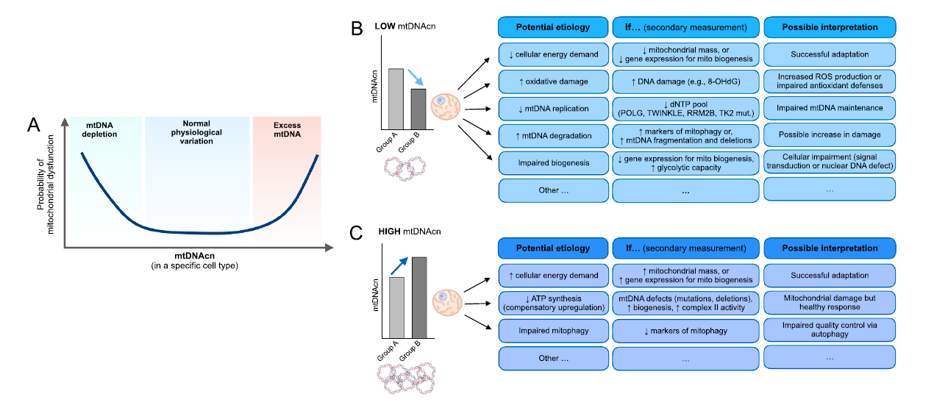
Image: Picard et al. 2021

Slide 35
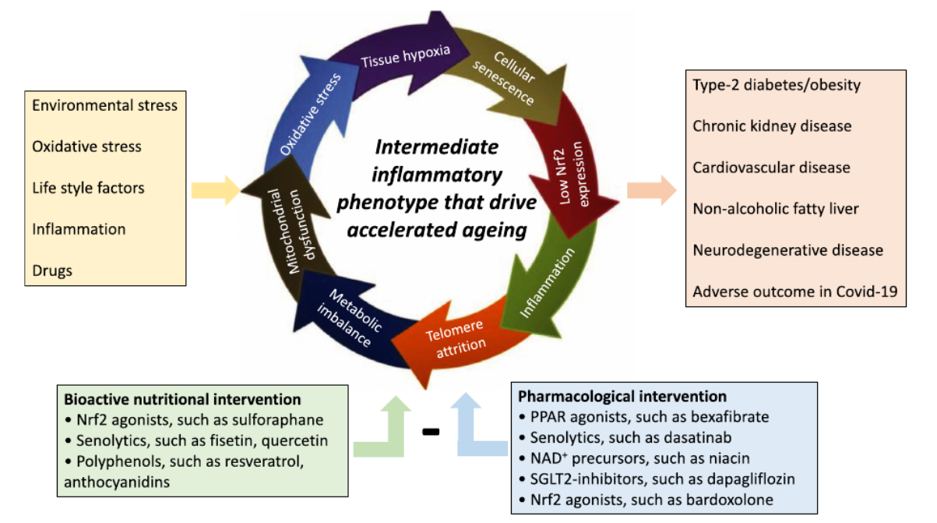
Image: Peter et al. 2021
Notes:
Here, we demonstrate that COVID-19 patients with high circulating levels of cell-free MT-DNA at the time of hospital presentation are more likely to require intensive care unit (ICU) care and intubation and are at heightened risk of death. In addition, MT-DNA quantitation as predictor of poor COVID-19 outcomes is comparable to or better than inflammation indicators commonly used in current clinical practice, as well as certain emerging immune markers (Scozzi et al. 2021)

Slide 36
Laboratory Measurements

Slide 37
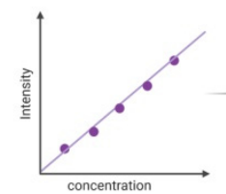
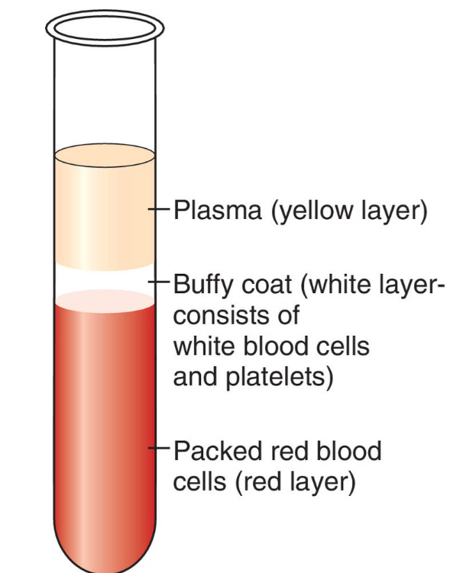
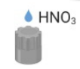
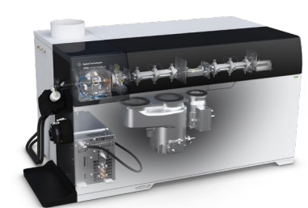
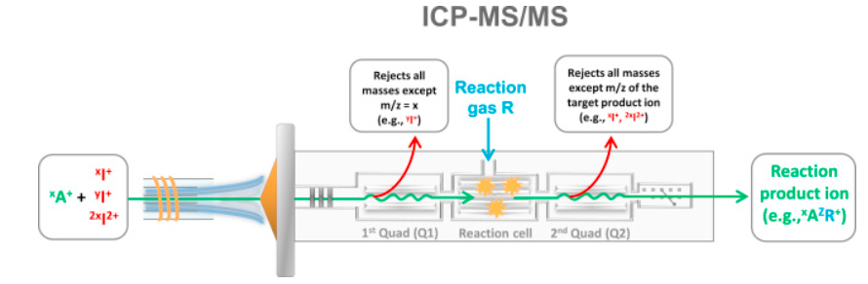
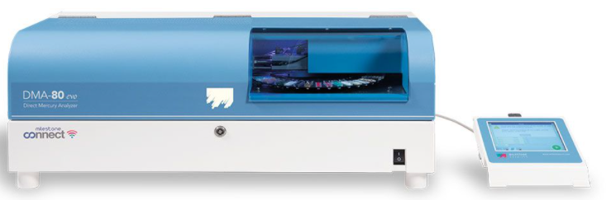
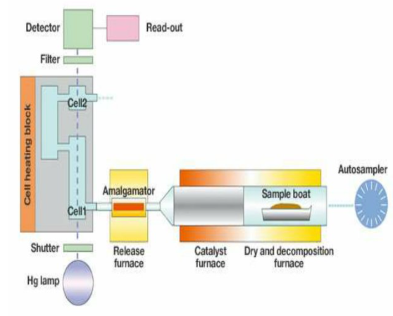
Metals Concentrations (all but Hg)
Obtain concentration of
As, Ba, Cd, Cs, Mg, Mn, Pb, Se, Zn
Notes:
Packed erythrocytes, digested with nitric acid, added on inductively coupled plasma-mass spectrometer (ICP-MS) in MS/MS mode; also referred to as triple quadrupole ICP-MS or ICP-QQQ; only allows ions with one m/z (mass divided by charge number) ratio to enter the cell leading to better control over the reactions taking place; determination of trace elements from calibration curve, consisting of multi-element standard solutions

Slide 38
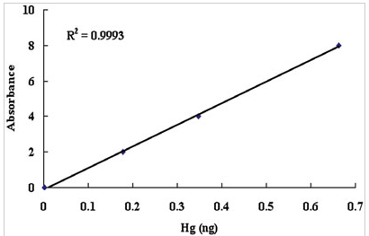
Metals Concentrations (Hg)
Obtain concentration of mercury
Notes:
Direct Mercury Analyzer 80- avoids sample preparation in which Hg could be lost

Slide 39
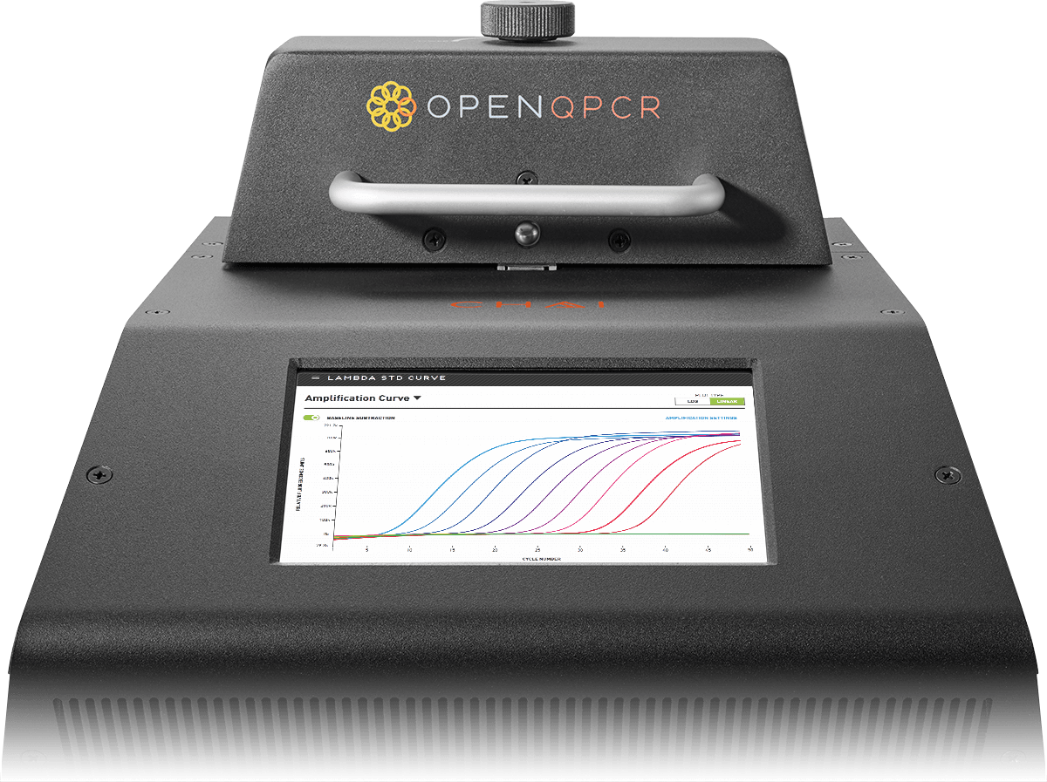
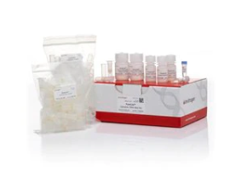
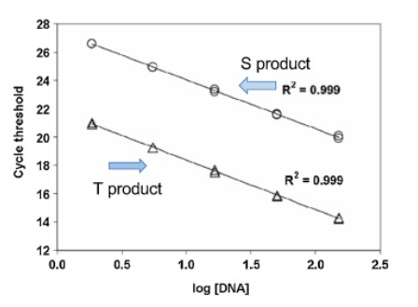
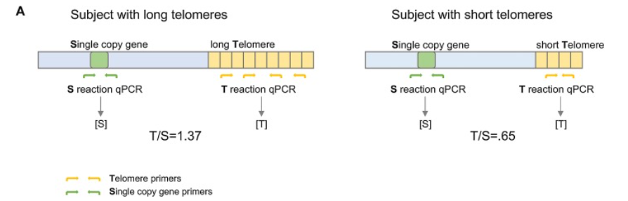
Relative Telomere Length
Notes:
Genomic DNA isolated from leukocytes in maternal blood and leukocytes and nucleated RBCs in cord blood using PureGene Kits (Fisher); concentrations were confirmed using PicoGreen quantification prior to amplification and Green Supermix;
The TL/single copy gene ratio (T/S ratio) was calculated as the ratio of TL copy number relative to albumin copy number, both of which were estimated by the Bio-Rad software (Bio-Rad Laboratories) using the study-specific standard curve
(Cq= slope*Log₁₀(Sq)+ intercept). Future: rLTL = (E^(Cq Tel calibrator – Cq Tel sample)) / ((E^(Cq SCG calibrator – Cq SCG sample))
Source of reference sample DNA: all maternal and cord blood samples in the study

Slide 40
Relative mitochondrial DNA copy number
mtDNA
mtDNA (ng)
nDNA
nDNA (ng)
Notes:
Genomic DNA isolated from leukocytes in maternal blood and leukocytes and nucleated RBCs in cord blood using PureGene Kits (Fisher); concentrations were confirmed using PicoGreen quantification prior to amplification;
The standard curve was made from a tissue-specific pooled sample comprising equal mass of total DNA from all samples analyzed in this study.
The starting quantity (ng) of mitochondrial and nuclear DNA for each sample was calculated based on the tissue-specific standard curve. The mtDNAcn was calculated by dividing the starting quantity of mtDNA (FAM SQ in the raw data file) by the starting quantity of nDNA (VIC SQ in the raw data file). Triplicates were then averaged to determine the mean mtDNAcn.

Slide 41
Adiposity Outcome Details

Slide 42
Study Methods: Outcome Characterization
Table 3. Adiposity and body size outcome sample sizes and distributions.
Visit [Mean age (SD)] | Sample Size | Outcome | Median (Interquartile range)
Early-childhood [3.3 years (0.3 years)] | 859 | Sum skinfold thicknesses (mm) | 16.00 (13.80, 18.80)
 | 882 | Waist circumference (cm) | 51.10 (49.20, 53.40)
 | 875 | Body mass index z-score | 0.72 (0.15, 1.36)
Mid-childhood [8.0 years (0.8 years)] | 599 | DXA total-fat-mass-index (kg/m²) | 3.86 (3.13, 4.93)
 | 599 | DXA trunk-fat-mass-index (kg/m²) | 1.19 (0.94, 1.65)
 | 747 | Sum skinfold thicknesses (mm) | 16.60 (13.35, 21.80)
 | 748 | Waist circumference (cm) | 58.25 (54.65, 62.62)
 | 745 | Body mass index z-score | 0.42 (-0.24, 1.22)
Early teen [13.2 years (1.0 years)] | 511 | DXA total-fat-mass-index (kg/m²) | 5.39 (4.15, 7.70)
 | 511 | DXA trunk-fat-mass-index (kg/m²) | 1.89 (1.41, 3.01)
 | 715 | Sum skinfold thicknesses (mm) | 24.00 (18.30, 34.70)
 | 717 | Waist circumference (cm) | 70.80 (65.70, 78.50)
 | 716 | Body mass index z-score | 0.47 (-0.27, 1.35)

Slide 43
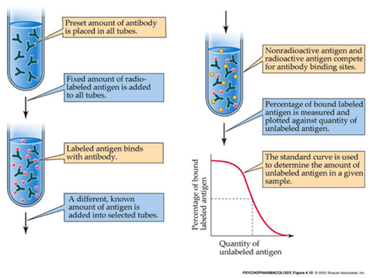
Adipocyte-secreted hormones
Notes:
Radioimmunoassay- determine conc. Of antigen (hormone, serum protein, drug, vitamin); very sensitive; relies on competitive binding, where a radioactive antigen competes with a non-radioactive antigen for a fixed number of antibody or receptor binding sites
Anti-leptin antibodies and adiponectin specific antibodies

Slide 44
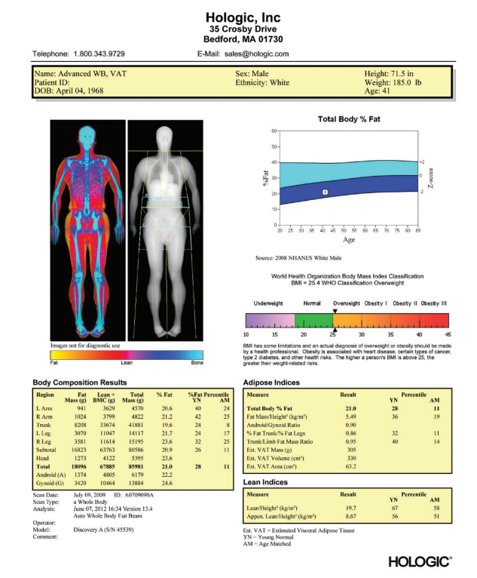
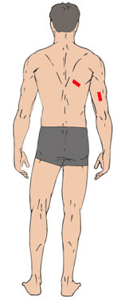
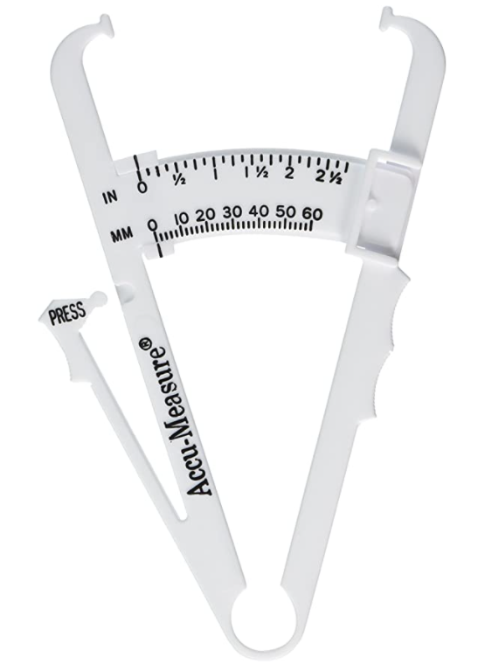
Adiposity Measures
Dual Energy
x-Ray Absorptiometry
Sum of skinfold thicknesses
Notes:
[total DXA fat mass in kg]/(height² in meters)
Soft tissue
DXA seems the most suitable method to measure body composition in the general population. It measures adipose tissue mass and distribution with great accuracy, accompanied by safe low radiation, short scanning time and low cost
Accurately measuring adipose tissue mass and its distribution

Slide 45
DAGs

Slide 46
DAG Aim 1
Confounders
Maternal BMI
Maternal smoking
Maternal age
Household income
Parity
Maternal race/ethnicity
Maternal education
Maternal diet
Child sex
Related to outcome
Sample plate
Cell-type/platelets
Exposures
Arsenic, barium, cadmium, cesium, lead, magnesium, manganese, mercury, selenium, zinc
Outcomes
Cord blood mtDNAcn
Cord blood TL
Maternal blood mtDNAcn
Maternal blood TL

Slide 47
DAG Aim 2
Confounders
Maternal BMI
Maternal smoking
Maternal age
Household income
Parity
Maternal race/ethnicity
Maternal education
Child sex
Exposures
As, Ba, Cd, Cs, Mg, Mn, Pb, Se, Zn, Hg
Outcomes
Cord blood leptin
Cord blood adiponectin

Slide 48
DAG Aim 2
Confounders
Maternal BMI
Maternal smoking
Maternal age
Household income
Parity
Maternal race/ethnicity
Maternal education
Child sex
Related to outcome
Child age
Exposures
Arsenic, barium, cadmium, cesium, lead, magnesium, manganese, mercury, selenium, zinc
Outcomes
Adiposity and body size at early- and mid-childhood and early teen

Slide 49
Mediation Model (Example)
Confounders (C2)
Maternal BMI
Maternal smoking
Maternal age
Household income
Parity
Maternal race/ethnicity
Maternal education
Child sex at birth
Gestational age at birth
Birthweight-for-gestational age & sex z-score
Confounders (C3)
Maternal BMI
Maternal smoking
Maternal age
Household income
Parity
Maternal race/ethnicity
Maternal education
Child sex
?
Sample plate
Cell-type
Exposure
Magnesium
Mediator
Cord blood mtDNAcn
Outcome
Waist circumference early teen
Confounders (C1) = C2 and C3
Child age
Notes:
Another way to think about the fourth assumption (no exposure to C2 effects) is that there should be relatively little time between the exposure and the mediator. If a substantial gap exists, then the fourth assumption requires that nothing on the pathway from the exposure to the mediator itself also independently affects the outcome. This assumption likely becomes increasingly less plausible the more time that elapses between the exposure and the mediator.
The confounding assumptions for mediation analysis are extremely important. Violations in these assumptions can give rise to very misleading results. Assumptions A1 (control for exposure outcome confounding) and A3 (control for exposure-mediator confounding) correspond to assumptions typically made in observational studies for total effects. What distinguishes the assumptions required in the mediation context is that control must also be made for mediator-outcome confounding (Assumption A2). This assumption is not necessary for the analysis of total effects, but it is needed for the analysis of direct and indirect effects. Moreover, to estimate direct and indirect effects, this assumption is needed even if the exposure has been randomized.
With either the traditional approaches or with the more recent approaches, for direct and indirect effects estimates to have a causal interpretation, we need Assumptions A1–A4. If researchers were to more regularly design studies so as to collect data on potential mediator-outcome confounders and adjust for these in mediation analysis, inferences about direct and indirect effects would be more likely to be valid.

Slide 50
Models

Slide 51
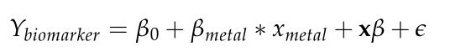
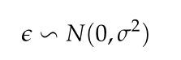
Multivariate Linear Regression
Β_{metal} is the target parameter
x is a matrix of covariates for the model
The random component follows a Gaussian distribution with mean 0 and constant variance:
Assumptions:
Correct model specification
Linear relationship between model terms and outcome
Normality of outcome/residuals
Can plot density of residuals
No or little multicollinearity
No auto-correlation
Observations are independent of each other (independence of outcome/residuals)
Homoscedasticity
Constant variance of residuals (scatter of residuals does not get wide/smaller as covariates change)
Notes:
*For Aim 2, will fit the same simple linear model, but using the GEE approach to get the inference accounting for the repeated measures
-We can use different working correlation matrices to fit the coefficients
-If use independence, the estimates will = that of standard logistic regression
-If use exchangeable (assuming that all observations on the same individual are equally correlated; gives something closer to equal weights to individuals than independence, which gives more weight to individuals with more observations) the estimates will = that of mixed models when have Gaussian distribution
-Robust inference will adjust for the correlation when deriving standard errors (estimate, then adjust residuals)
*For marginal models (GEE), focus not on modeling sources of variability, but just estimating the so-called “marginal” regression model; describes how means change in populations of individuals as covariates change (population average models); thus, the parameter of interest is E[Yij | Xij=xij] is defined as the mean value of an observation Yij in theoretical experiment where one randomly draws an observation from a population where everyone has Xij=xij
*Coefficients in a random effects model can be interpreted as expected “differences” (odds ratios, relative risks, etc.) within an individual, given a change in their X from one value to another
*Coefficients in a marginal model represent expected differences (odds ratios, relative risks, etc.) comparing populations defined by differences in X.
*GEE software typically allows several different working correlation models that are used in the estimating phase of GEE
*These correlation models are used to build weight matrices, which are used in a weighted regression
*When deriving inferences for the coefficients, though, it calculates “robust” standard errors, which does not assume one guessed the right correlation model
*GEE will normally return two estimates of the variance of the coefficient estimates, 1) naïve and 2) robust.
-Naïve assumes chosen model is correct
-Robust is a more nonparametric estimate that does not assume your guess is correct

Slide 52
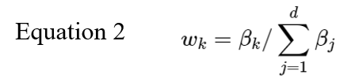
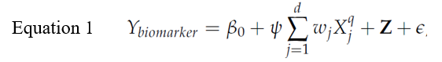
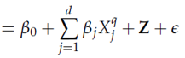
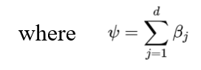
Quantile g-computation
Since directional homogeneity does not hold, the weights for each exposure are negative or positive, which are interpreted as the proportion of the negative or positive partial effect due to a specific exposure (positive and negative weights both sum to 1.0) (equation 2).
Categorize metals in quantiles and fit linear model.
Transform exposures (metals), X_{j}, into quartiles, which = 0, 1, 2, or 3 for any participant, corresponding to whether exposure (metals) falls into 0-25th, 25th-50th, 50th-75th, or 75th-100th percentile.
Fit linear model with confounders Z, where β₀ is model intercept, w_{j} are the weights for each exposure (here we have d exposures), X^{q}_{j} is the quantized version of the jth exposure, E is the error term and β_{j} is the effect size for exposure j (equation 1). The estimator of the exposure-response function, psi, is the coefficient representing the incremental change in the expected value of Y per unit increase in exposure index.
Method: Keil et al. 2020
Notes:
This is a projection of a linear model that allows estimation of mixture coefficient under joint distribution of the mixtures and covariates
Test assumptions moving forward

Slide 53
Quantile g-computation
Standard Causal Identification Assumptions:
Randomization assumption
Strong ignorability or no unmeasured confounding.
No interference between units
The potential outcomes of one individual are assumed to be unaffected by the treatment assignment of other individuals.
Consistency of treatment mechanisms
Positivity or overlap
All observed units, across strata defined by W, have a bounded (nondeterministic) probability of receiving treatment.

Slide 54
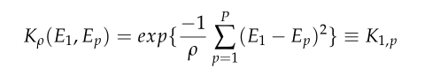
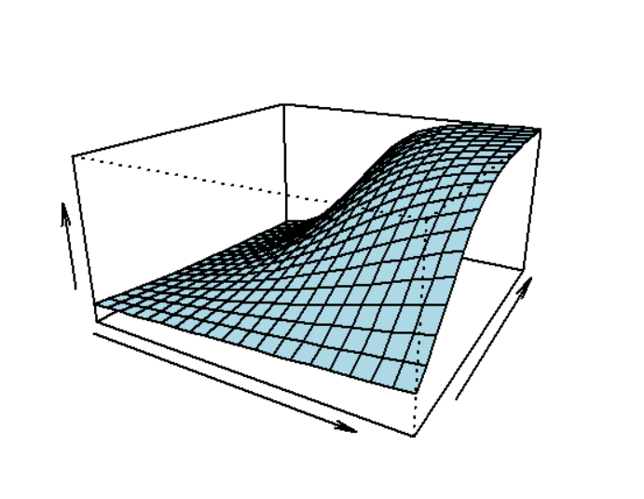
Bayesian Kernel Machine Regression
For a given continuous, normally distributed biomarker outcome (Y), the BMKR model takes the form:
Y=β₀ + h₁(E₁, …, E_{p}) + βx + ε, where (E₁, …, E_{p}) represents px1 vector containing the concentrations of the ten metals in the mixture and h(.) is an unknown but smooth function.
Use the Gaussian kernel, which implies a radial basis representation for h₁(E₁, …, E_{p})
We tie this multi-pollutant exposure by assuming a pair of random effects (E₁, …, E_{p}) are correlated; the strength of this correlation is determined by the “distance” between a pair in the multivariate exposure space.
By selection of the distance metric (kernel function), BKMR can accommodate nonlinear and non-additive effects of the multivariate exposure.
Method: Bobb et al. 2015
Notes:
This approach yields a convenient score to conduct a hypothesis test for the overall mixture effect for the 10 metals: (Ho: h1(.)=0), as well as ways to identify individual metals that play an important role in each kernel function (variable selection). To ease interpretability, graphical representation of the outcome by metal mixture will be done by plotting 2-dimensional and interaction exposure response functions of each individual metal by quartiles of other metals. For effect sizes, we will estimate mixture associations at fixed quantiles levels of metal exposure and pick medians as the reference.

Slide 55
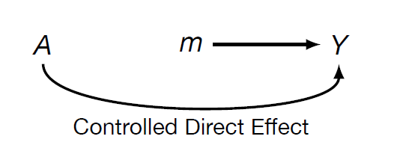
Causal Mediation Analysis
Natural direct effect measures effect of exposure on outcome through all other parts, or effect of exposure on outcome if mediator took natural value
Natural indirect effect measures effect of exposures on the outcome through the mediator, or effect of mediator on outcome if exposure was fixed
Controlled direct effect measures the effect of the exposure on the outcome if one controlled (or intervened on) the mediator to achieve a set level

Slide 56
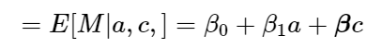
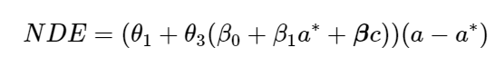
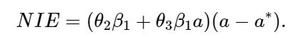
Causal Mediation Analysis
Natural direct effect measures effect of exposure on outcome through all other parts, or effect of exposure on outcome if mediator took natural value
Natural indirect effect measures effect of exposures on the outcome through the mediator, or effect of mediator on outcome if exposure was fixed
Given Y=adiposity, A=metal, M=biomarker, C=confounders,
Outcome regression
Mediator regression
Natural direct/indirect effects for change in exposure from level a to level a* are given by:
Notes:
Based on the theory of counterfactuals (what a subject’s mediator and outcome would have been if that person had instead received an alternative exposure level),
Effects measured from regression parameters
Standard errors for these expressions are available in statistical packages

Slide 57
Causal Mediation Analysis
For natural effects, direct and indirect effects decomposed into:
Pure direct effect: effect of exposure if mediator stayed at unexposed level
Pure indirect effect: effect of mediator in unexposed
Total direct effect: effect of exposure if mediator fixed at exposed level
Total indirect effect: effect of mediator among exposed
Controlled effects: direct effect may vary depending on level to which mediator set
Pure = total effects if no exposure-mediator interaction

Slide 58
Causal Mediation Analysis
Randomization assumption
Strong ignorability or no unmeasured confounding (see next slide)
Treatment or mediator positivity
Cross-world counterfactual independence
Counterfactual outcome under treatment contrast and counterfactual mediator are independent

Slide 59
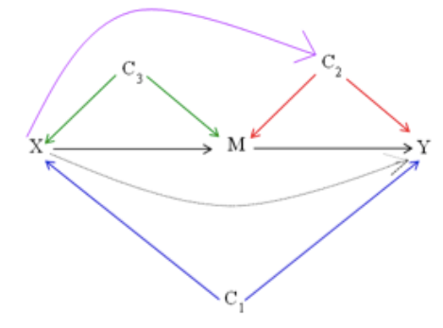
Causal Mediation Analysis
4 main confounding assumptions for causal mediation
Controlled effects
No unmeasured X->Y confounding (C1)
No unmeasured M->Y confounding (C2)
Natural effects (i) and (ii) plus
iii. No unmeasured X->M confounding (C3)
iv. No M->Y (C2) confounder that is caused by X
Notes:
Another way to think about the fourth assumption (no exposure to C2 effects) is that there should be relatively little time between the exposure and the mediator. If a substantial gap exists, then the fourth assumption requires that nothing on the pathway from the exposure to the mediator itself also independently affects the outcome. This assumption likely becomes increasingly less plausible the more time that elapses between the exposure and the mediator.
The confounding assumptions for mediation analysis are extremely important. Violations in these assumptions can give rise to very misleading results. Assumptions A1 (control for exposure outcome confounding) and A3 (control for exposure-mediator confounding) correspond to assumptions typically made in observational studies for total effects. What distinguishes the assumptions required in the mediation context is that control must also be made for mediator-outcome confounding (Assumption A2). This assumption is not necessary for the analysis of total effects, but it is needed for the analysis of direct and indirect effects. Moreover, to estimate direct and indirect effects, this assumption is needed even if the exposure has been randomized.
With either the traditional approaches or with the more recent approaches, for direct and indirect effects estimates to have a causal interpretation, we need Assumptions A1–A4. If researchers were to more regularly design studies so as to collect data on potential mediator-outcome confounders and adjust for these in mediation analysis, inferences about direct and indirect effects would be more likely to be valid.

Slide 60
Splines

Slide 61
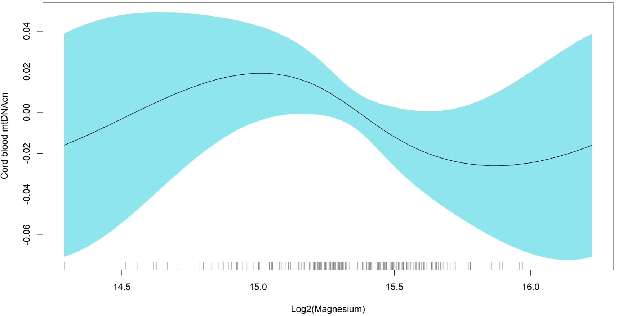
Nonlinearity detected in generalized additive models for the association between cord blood mitochondrial DNA copy number (mtDNAcn) and magnesium

Slide 62
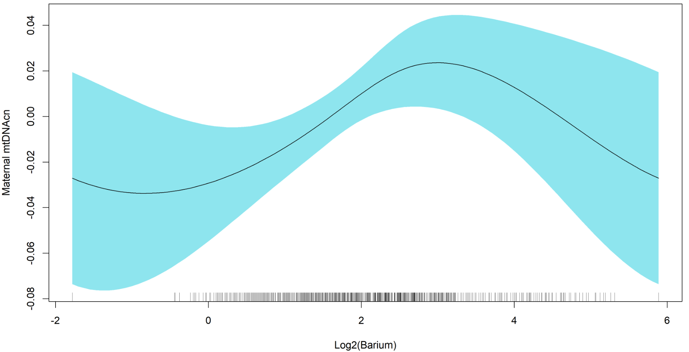
Nonlinearity detected in generalized additive models for the association between maternal blood mitochondrial DNA copy number (mtDNAcn) and barium

Slide 63

Nonlinearity detected in generalized additive models for the association between maternal blood mitochondrial DNA copy number (mtDNAcn) and mercury

Slide 64

Nonlinearity detected in generalized additive models for the association between maternal blood mitochondrial DNA copy number (mtDNAcn) and lead

Slide 65

Nonlinearity detected in generalized additive models for the association between maternal telomere length (TL) and barium

